Slide 1
MULTIPLEXER
1

Slide 2
Instructor
Presented by
MR. SYED AHSANUL KABIR
Associate Professor
Dept. of CSE
Green University
JOY PAL
ID: 201002418
Sec.: 203DA
Dept. of CSE
Green University
2

Slide 3
CONTENTS
1. Introduction
2. Examples
3. Advantages & Disadvantages
4. Applications
3

Slide 4
Multiplexer
A Multiplexer (MUX) is a digital switch that has multiple inputs and a single output.
Also known as Data Selector.
The select lines determine which input is connected to the output.
(Inputs)
.
.
.
(Output)
MUX Types -
2-to-1 (1 select line)
4-to-1 (2 select lines)
8-to-1 (3 select lines)
16-to-1 (4 select lines)
(Select lines)
4

Slide 5
4 to 1 multiplexer
I0
4:1
MUX
Input |  | Output
S1 | S0 | Y
0 | 0 | 0 I0
0 | 1 | 1 I1
1 | 0 | 1 I2
1 | 1 | 1 I3
I1
Y
I2
I3
S0
S1
5

Slide 6
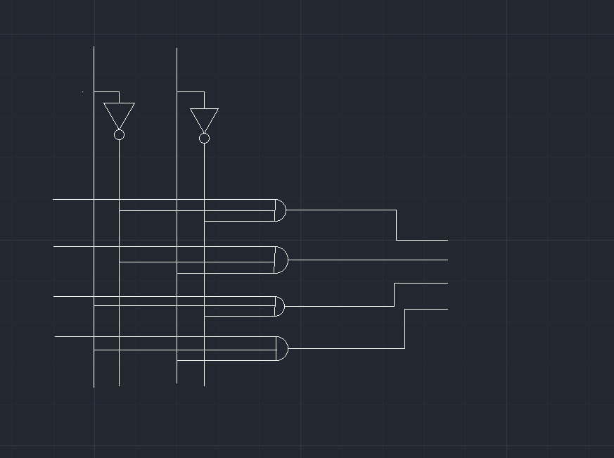
4 to 1 multiplexer
S1
S0
I0
I1
Y
I2
I3
6

Slide 7
Advantages
It reduces number of wires.
It reduces complexity and cost.
It does not need K-maps and simplification.
It can be extended to switch audio signals, video signals, etc.
Disadvantages
Adder delays in switching port.
Limitations on which ports can be used simultaneously.
Extra I/O ports required to control the multiplexer.
7

Slide 8
Applications
Communication system
Telephone network
Computer memory
Transmission from the computer system of a satellite
8

Slide 9


9

